Slide 1

WATER DISPENSION SYSTEM
SUBMITTED BY:-Jyoti Ranjan Behera
BRANCH:- MCA (4th Sem)
SECTION:-
REGD NO:- 2405432035
ORGANIZATION:- Robogenisis
NAME OF INTERNAL GUIDE:-Mukesh kumar singh

Slide 2
CONTENT
SL NO | ACTIVITY | SLIDE NO.

Slide 3
Introduction
The rapid growth of urbanization has increased the demand for accessible and clean drinking water. Traditional methods face challenges like inefficient payment and lack of tracking. This project modernizes water distribution through a smart management and billing system.

Slide 4
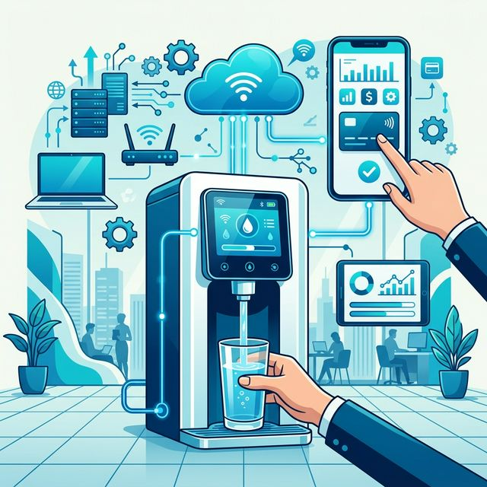
Project Overview
A full-stack web application built with Node.js, Express, MongoDB, and React (Vite+Tailwind). It integrates Razorpay and Cashfree for automated water dispensing and digital billing.

Slide 5
Objectives
- Automate digital billing and payment collection. - Eliminate manual cash handling. - Implement real-time transaction processing. - Develop a responsive and accessible user interface.

Slide 6
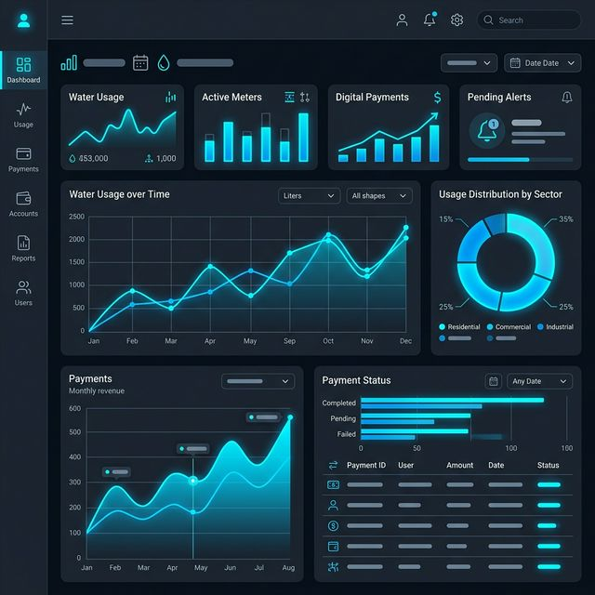
Results and Findings
Successfully implemented a reliable smart water management system. Fully integrated Razorpay and Cashfree for zero-latency payments. Developed an intuitive React frontend and a secure Node/Express backend.

Slide 7
Analysis and Discussion
The integration of digital payment gateways significantly reduced operational overhead. Challenges included ensuring secure transaction verification and providing real-time feedback, resolved using robust Express APIs and MongoDB.

Slide 8
Summary of Internship
Learned full-stack web development (MERN stack). Gained practical experience in integrating third-party payment gateways (Razorpay, Cashfree) and building scalable backend architectures.

Slide 9
Conclusion
The Water Dispension system successfully bridges physical utilities with digital convenience. The project provided invaluable industry experience in full-stack development and modern application architecture.

Slide 10
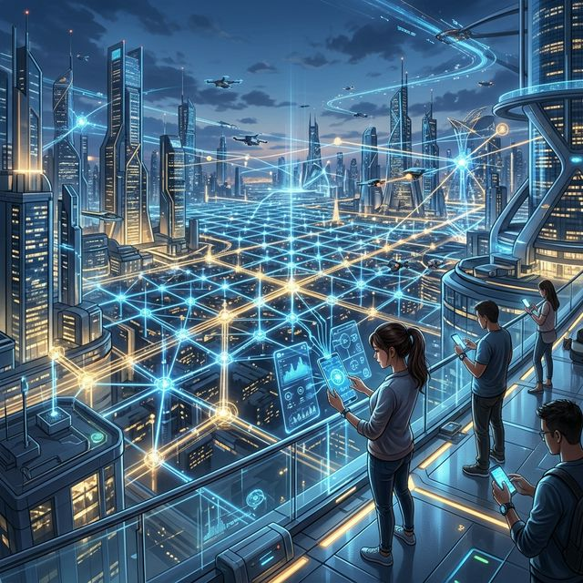
Future Directions & Advanced Internships
Future improvements include IoT integration for hardware-level dispensing control, advanced analytics for water usage tracking, and a dedicated mobile application for greater user accessibility.

Slide 11
THANK YOU

